Slide 1
Partner Dashboard
GME B2B

Slide 2
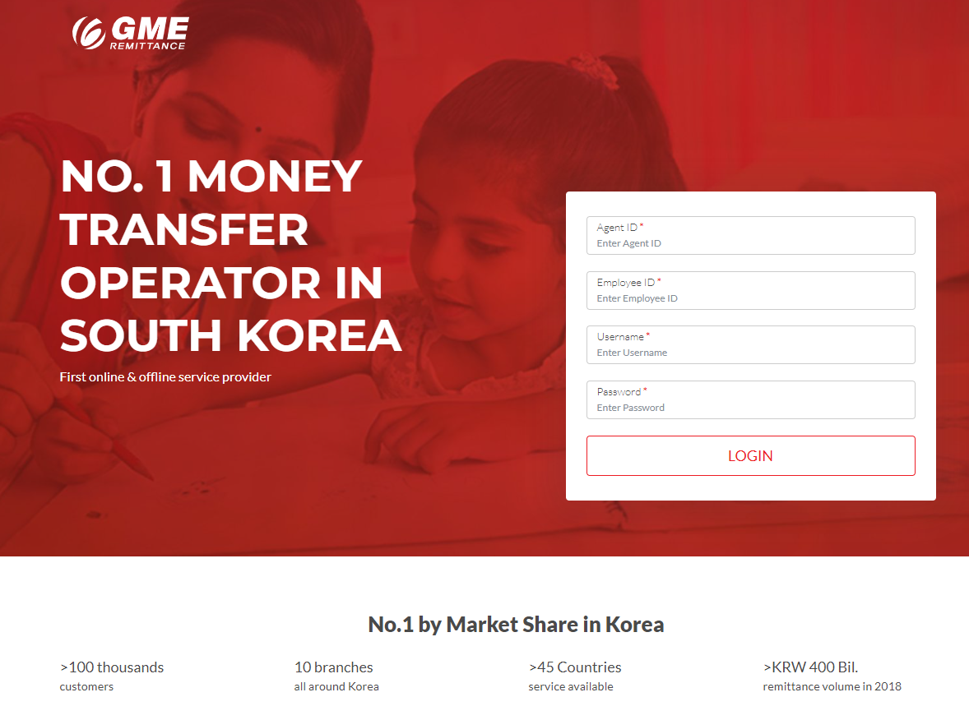
GME will provide the credentials to partners.
(Max. 3 accounts)
Over 1 Mil.
customers
12 branches
all around Korea
186 Countries
service available
>KRW 1 Bil.
remittance volume

Slide 3
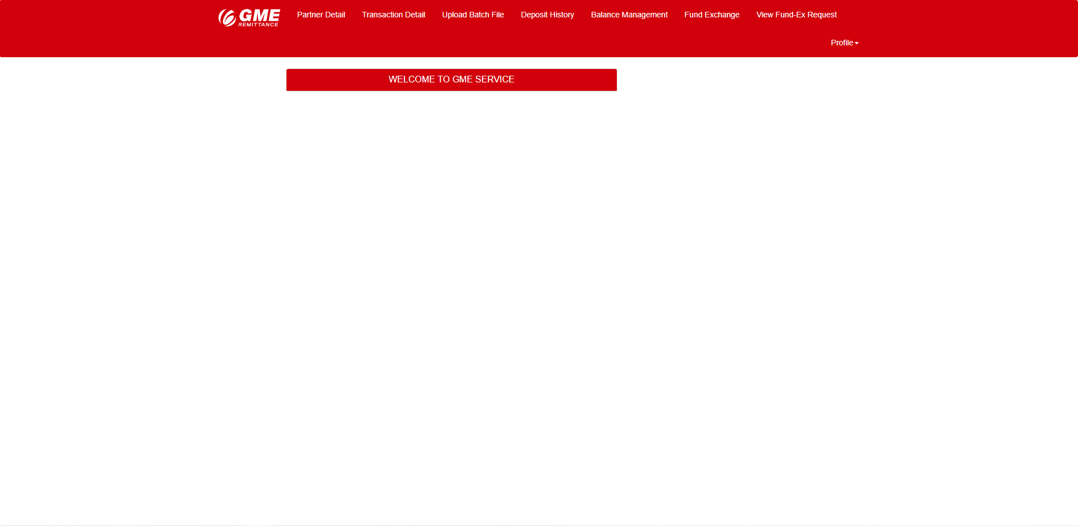

Slide 4
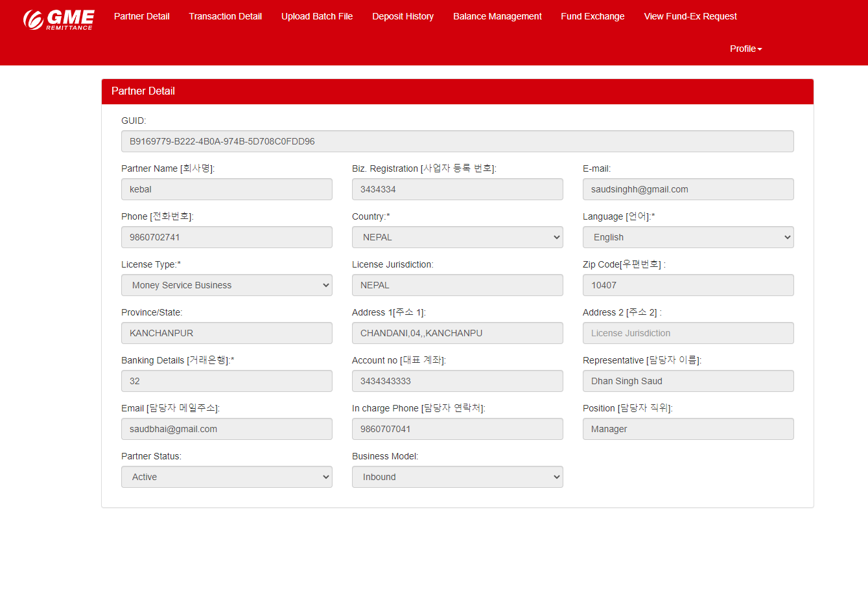
UNITED STATES
View Only Purpose
UNITED STATES
22139
FLORIDA
RIDERWOOD

Slide 5
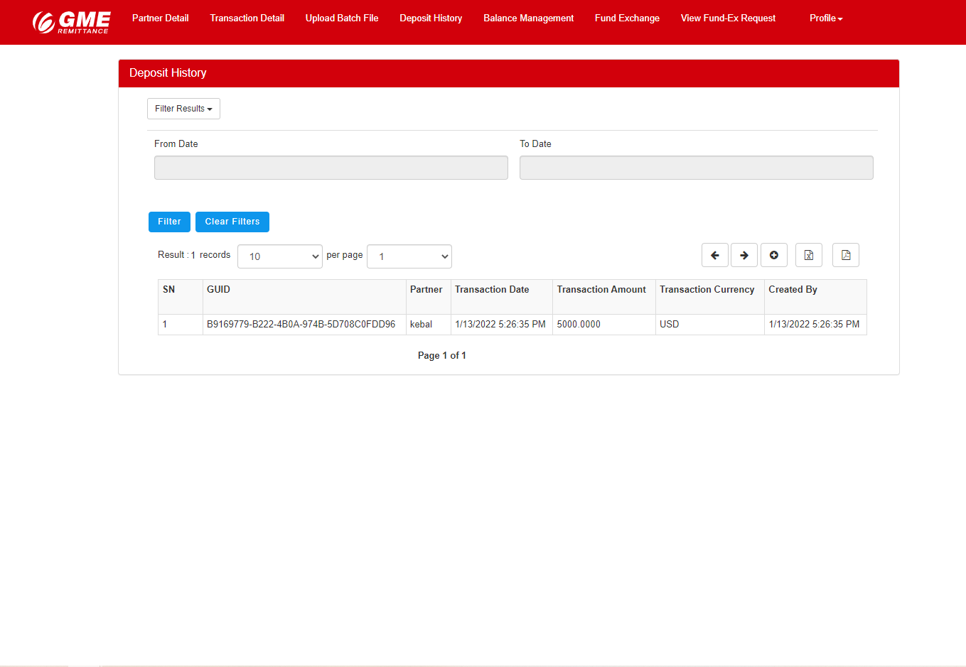
Once you deposited to GME’s USD account, you can check your Deposit History on this page with the details as shown

Slide 6
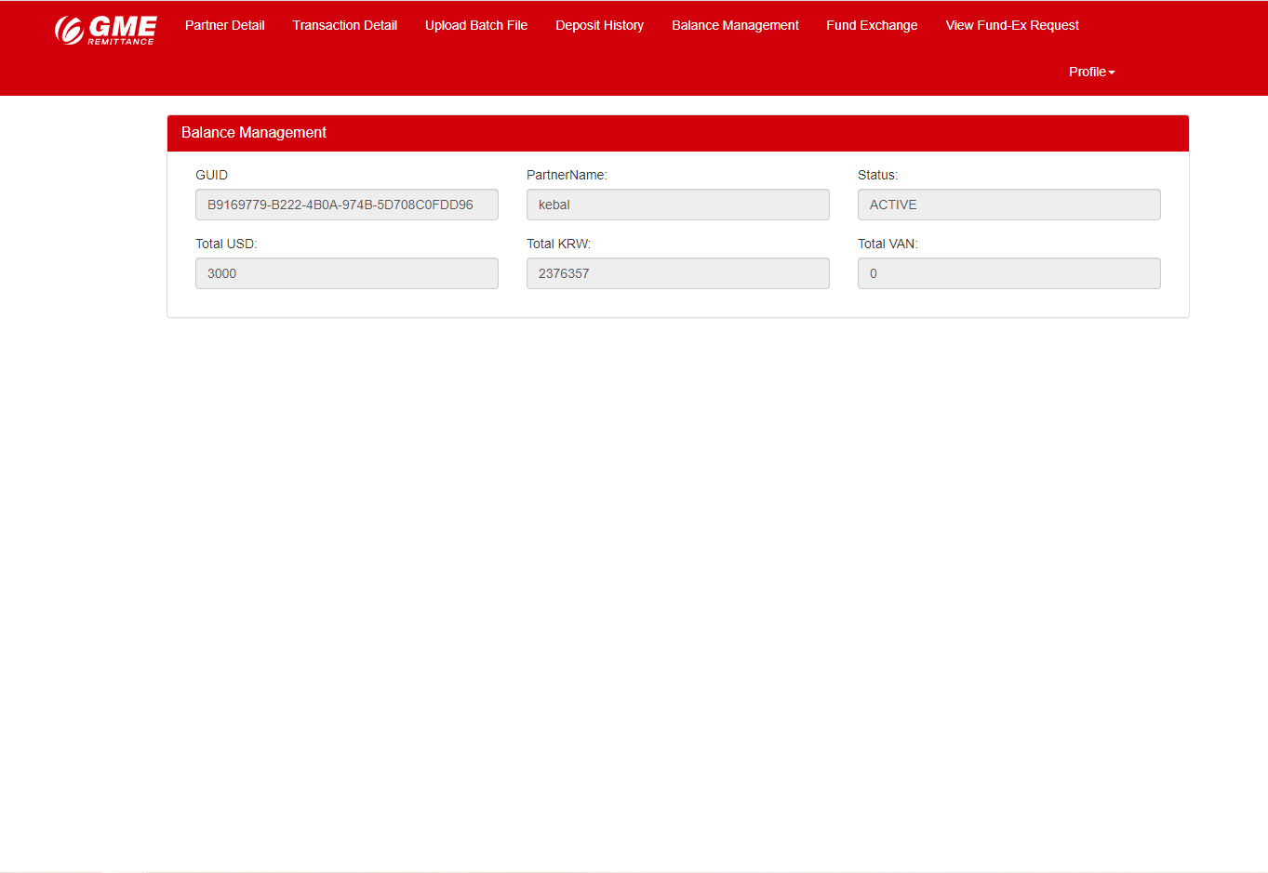
You can check your balance in USD and KRW on this page

Slide 7
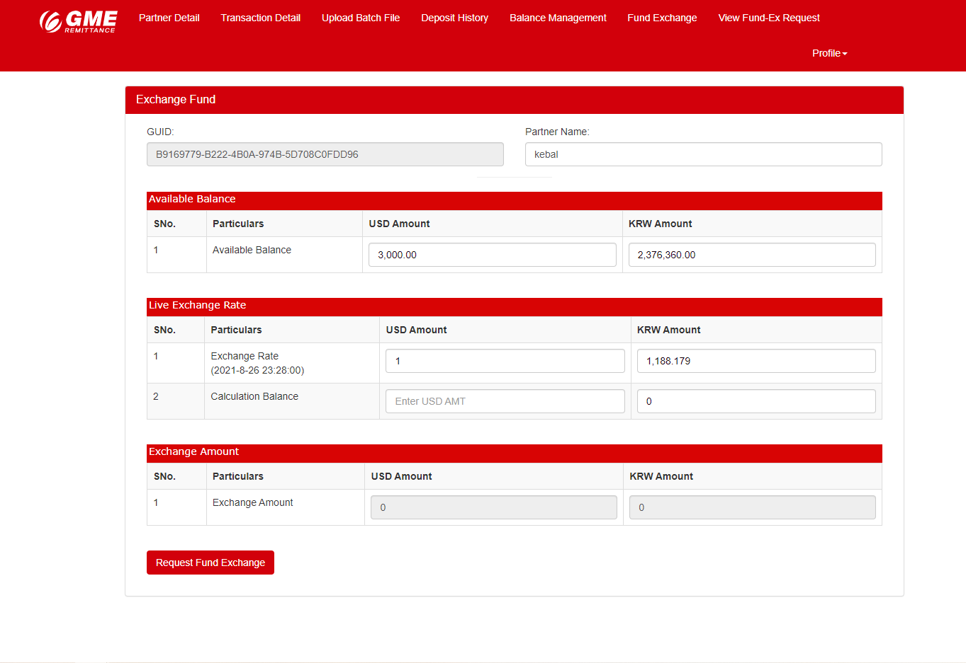
On this page you can see the real time rate and you can request for fund exchange by entering the required USD amount.
PS:
Staging = Rate changes per 15min.
Production = Rate changes per 1min.

Slide 8
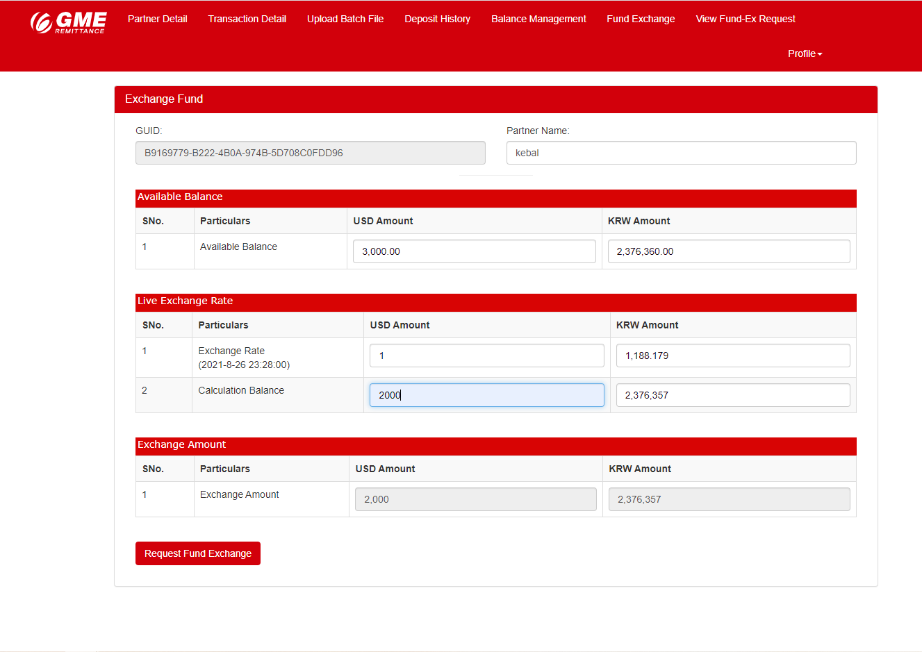
Once you enter the required USD amount, the system will automatically show the total KRW amount. Then, you can click on the “Request Fund Exchange” to lock the rate.
Please kindly note that GME will approve all requests within 15 Min.

Slide 9
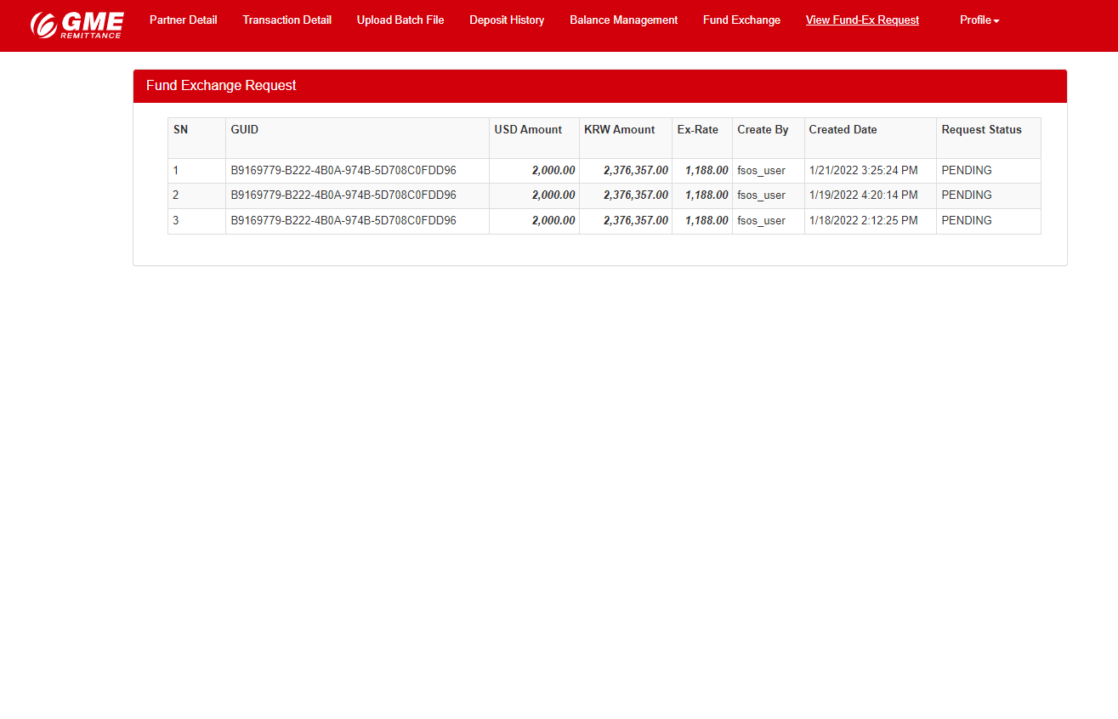
APPROVED
APPROVED
APPROVED
On this page you can check all the history of Fund Exchange Request and the status

Slide 10
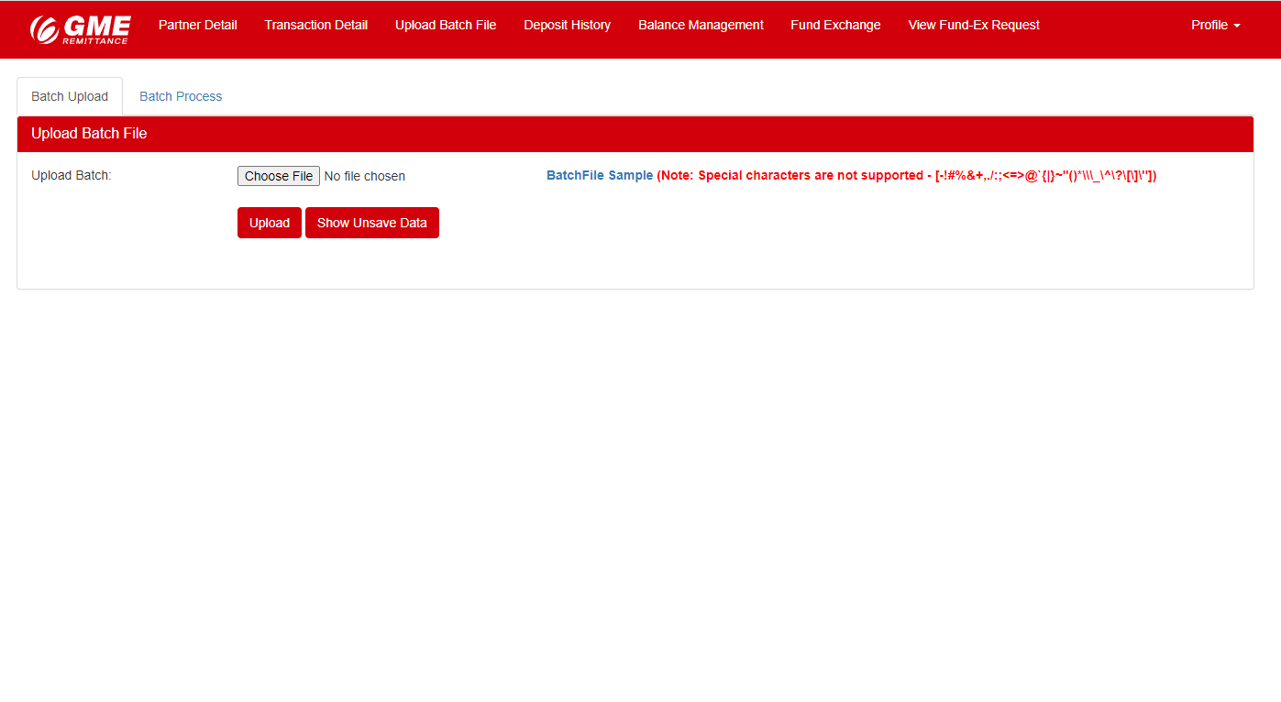
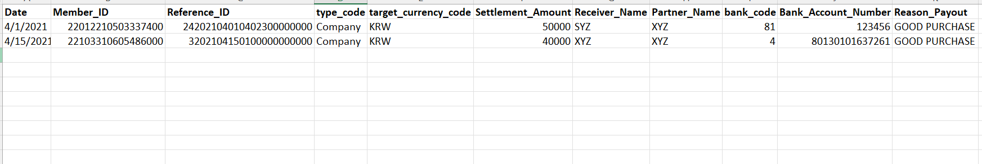
Data in BatchFile:
Date
Member_ID: 14 Characters (Receivers ID on Partner's side)
Reference_ID: YYYYMMDD + 8 Characters (ID to track Transactions on Partner's side)
Type_code: Individual/Company
Target_Currency_Code: KRW
Settlement_Amount: in KRW
Receiver_name: Last Name + First Name (Full Name of Receiver
Partner_name
Bank_code: Beneficiary bank code
Bank_Account_Number: Beneficiary’s bank account number
Reason_payout: GOOD PURCHASE (Static)
Once you check your balance, you can upload your file in this menu by click on “ Choose File”.
Click on ”Batch File Sample” to download the sample as shown below

Slide 11
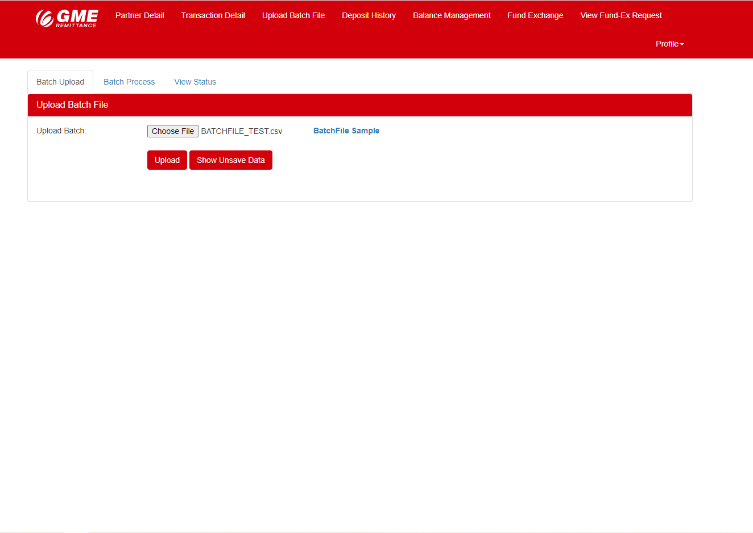
After you check that you uploaded the right file, click on “Upload”
Please note that file must be saved in CSV UTF-8 format

Slide 12
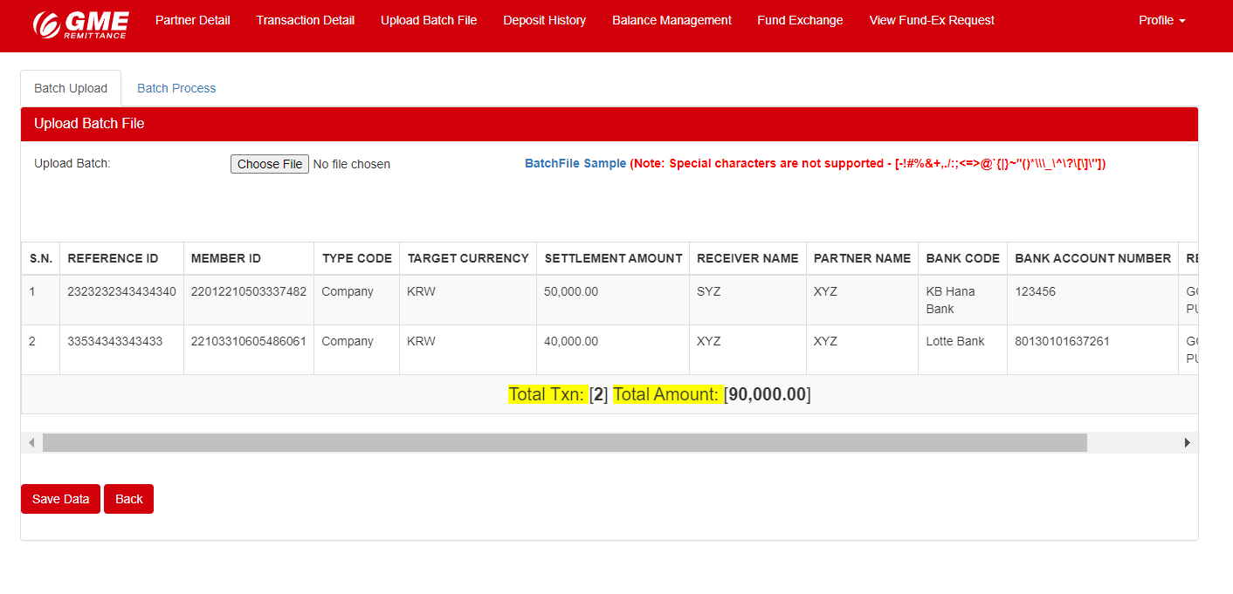
You will be able to preview and recheck all transactions data from the uploaded file before you save it. (as shown on the left side)
Please note that the data deployed in this interface will remain as it is unless you save it.

Slide 13
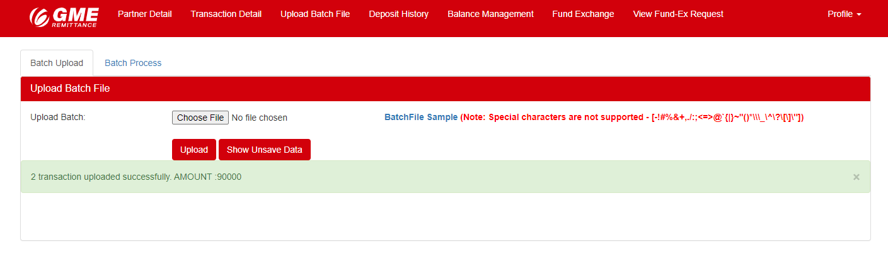
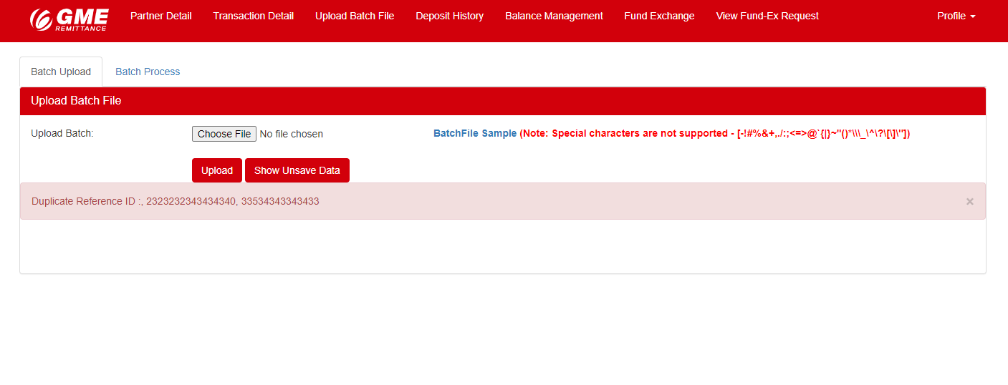
This page will be shown when all data is successfully saved. Save data will directly move to “Batch Process” menu.
To minimize the risk of duplicate transaction processing, each transaction reference ID has to be unique. All duplicated reference ID will be rejected.

Slide 14
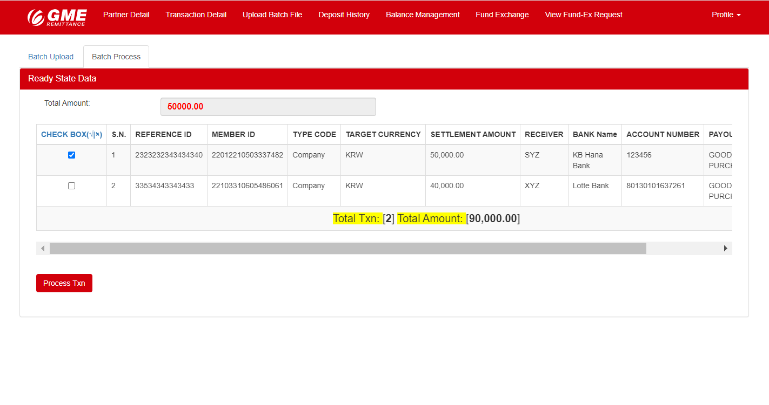
All transactions data is READY once it is successfully saved.
In this menu you can select on the transactions you want to process. Please note that you can click on the “CHECK BOX” to select/deselect all transactions.

Slide 15
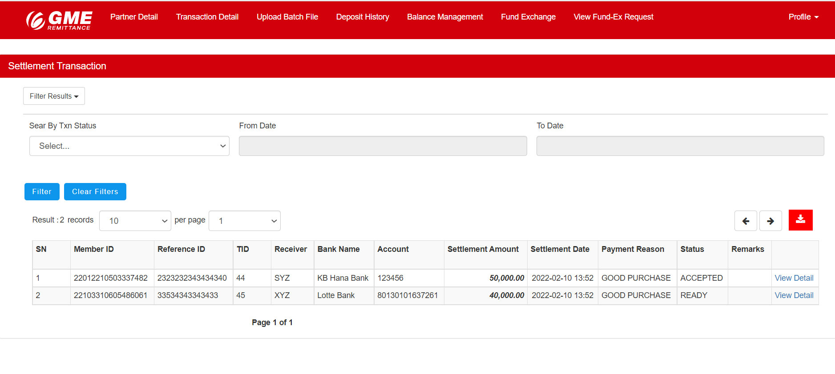
All transactions history will be shown in this menu.
Transaction status “ READY” means transaction is only saved and NOT processed.
Transaction status “ ACCEPTED” means transaction is processed.
P.S:
Staging: 2 Transaction Status ( READY and ACCEPTED)
Production: 5 Transaction Status (details on last page)

Slide 16
Click here to download the transactions statement.
Click on “DETAIL” for each transaction details information and receipt

Slide 17
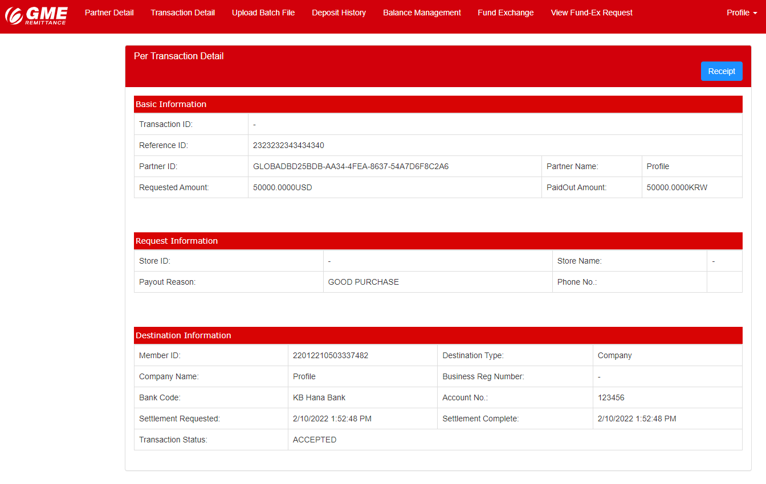
Transaction details will be shown as beside picture. Click on “Receipt” to save or print out.

Slide 18
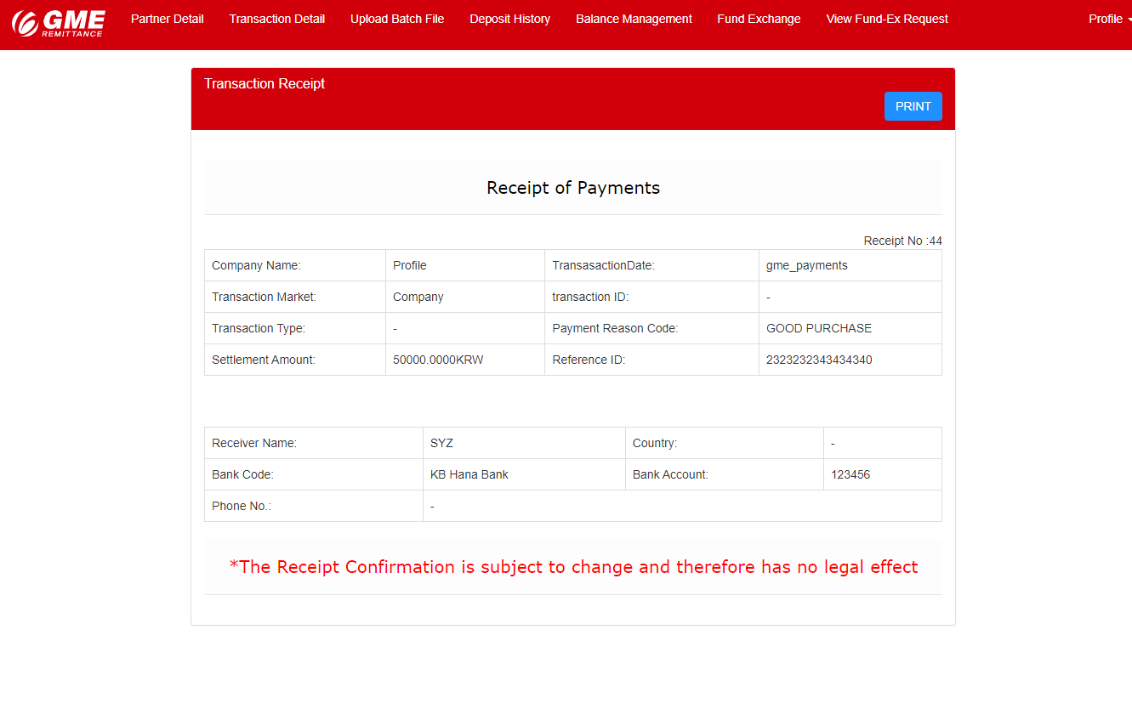
Transaction Receipt shown as beside picture. Click on “PRINT” to save as PDF file or to print out the receipt.

Slide 19
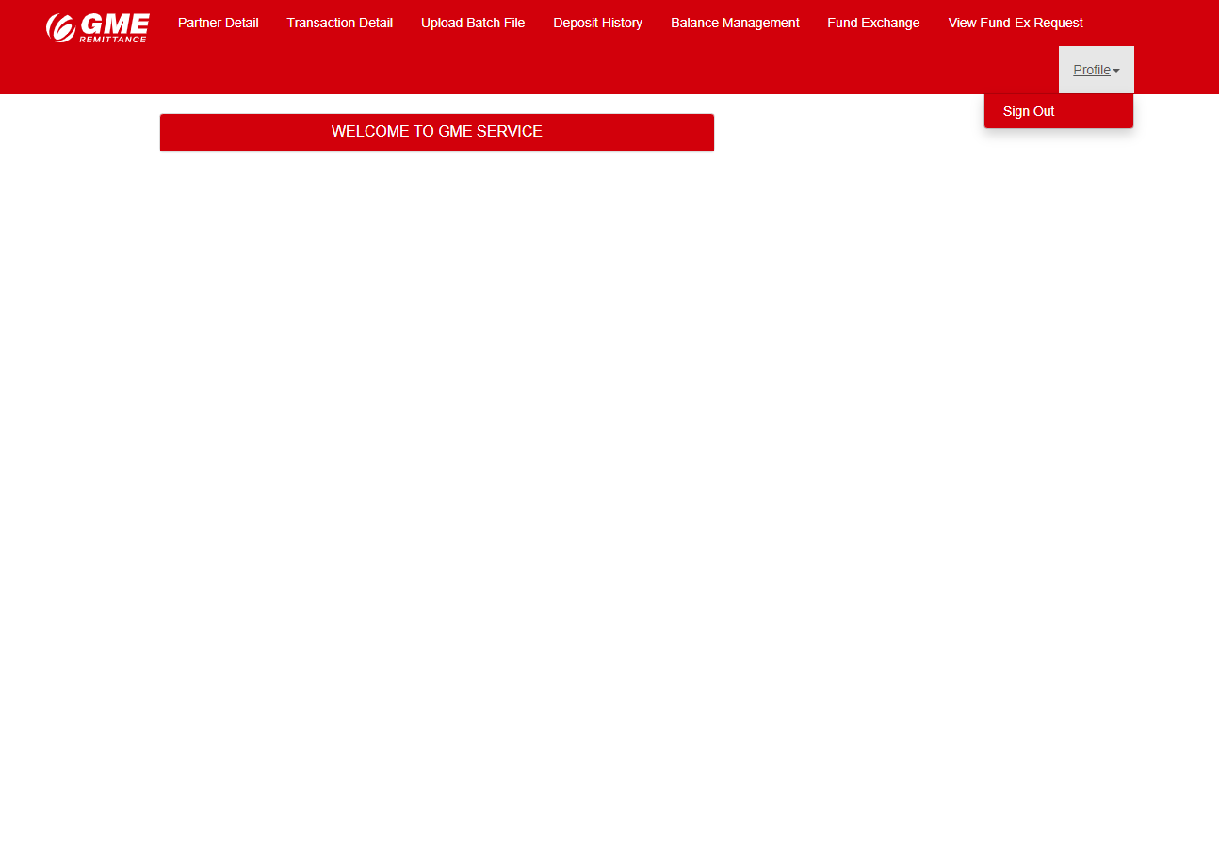
Click on “Profile” then “Sign Out” to sign out from the dashboard

Slide 20
Transaction Status | Transaction Status | READY
1. | READY | Transactions are saved but not processed. You can find READY transactions data in “ Upload Batch File” then “Batch Process” (page 14)
2. | ACCEPTED | Transactions are processed and send to GME portal. From this status, only GME can cancel the transactions.
3. | PROCESSING | GME is checking Compliance, Balance, Account Validation, etc.
4. | FAILED/ PENDING DEPOSIT | Showing if transaction fail/success in Compliance, Balance, Account Validation, etc. GME will show the reason for FAILED cases in the remark column.
5. | PAID/ FAILED TO DEPOSIT | Transaction is pushed to the bank. Deposit date and time will be shown in the remark column.

